Slide 1

UNIT VI
STRATEGIC MANAGEMENT

Slide 2
INTRODUCTION
Management functions viz., planning, organizing, staffing, directing and controlling are required to achieve organizational objectives.
Without setting an objective, there is nothing to organize, direct or control. Hence, every organization needs to specify what it wants to achieve.

Slide 3
CORPORATE PLANNING
Plan is a commitment to a particular course of action believed necessary to achieve results.
Corporate planning refers to the process of planning undertaken by the management to achieve their organizational goals.

Slide 4
Very often the terms Mission, purpose, objective, goal, target etc are used interchangeably but there is a difference.
Enduring reasons Specific results
Why an organization that an individual
Exists in the orgn achieves
in a specific period.

Slide 5
MISSION
Mission statement defines the basic reason for the existence of an organization and provides the basic philosophy of what the company is all about.
Mission statement can be very effective if they are guided by a vision or a challenging dream that directs the efforts of the company for the years to come.

Slide 6

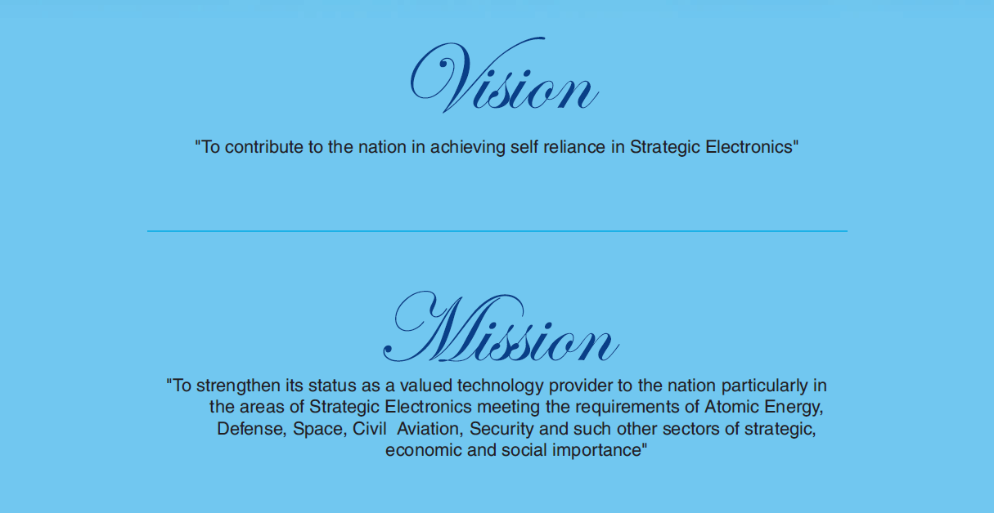
Example : Mission Statements

Slide 7


Google’s mission is to organize the world’s information and make it universally accessible and useful.
ITC’s mission : To enhance the wealth generating capability of the enterprise in a globalizing environment, delivering superior and sustainable stakeholder value

Slide 8
CHARACTERISTICS
It must be clear enough to trigger action
It focuses on customer needs and utilities, not products
It should be capable of being measured in terms of specific targets
It should focus on limited number of goals
It outlines the major policies and values the company wants to honor
It identifies the core principles to guide decision making
It should be flexible
It provides for shared vision

Slide 9
GOALS
Goals are the overall objectives of a department or an organization.
It is defined as what an organization wants to achieve during or by the end of a given period.
The purpose of goals is to give you something that you want to enhance your life in some way, so the most important thing you need to know about goals is that you ought to have some.

Slide 10
Types of Goals
Long Term Goals: 10-year, 5-year and 1-year goals
Short Term Goals: goals for the next 9 months, 6 months and 3 months
Immediate Goals: 1-30 days from now

Slide 11
5 Qualities of Effective Goals S.M.A.R.T.
The Goal should be SPECIFIC enough so that we know exactly for what we are striving.
MEASURABLE A goal must be MEASURABLE. It should have concrete facts. You should be able to answer very specifically, when and how you will know you attained your goal.
ACTION ORIENTED, declaring positive activity that will produce results.

Slide 12
REALISTIC A goal must be REALISTIC. Challenging yourself is an important part of goal setting. You want to aim high; however, you also need to be realistic.
TANGIBLE meaning concrete and not vague

Slide 13
SIGNIFICANCE
It helps to define the organization in its environment
It helps in coordinating decisions
Goals are more tangible targets
It facilitates performance appraisal

Slide 14
OBJECTIVES
Once the mission is clear, goals are fixed for individual departments, the next stage is to break down the goal into objectives for every level in the organization. Objectives are more precise and used to specify the end results which an organization wants to achieve.
A management objective is the intended goal that prescribes definite scope and suggests direction to the planning efforts of a manager.

Slide 15
STRATEGY
Strategies give direction for the achievement of objectives necessary through the deployment of resources.
A strategy is an operational tool to achieve the goals.

Slide 16
ENVIRONMENTAL SCANNING
Environmental scanning is a vital part of the corporate planning process.
Effective planners try to anticipate what is likely to happen or attempt to influence the environment in favorable directions.

Slide 17
External
Environment Analysis
General Environment
Industry Environment
International Environment

Slide 18
Internal Environment: Analysis & Diagnosis
Internal analysis and diagnosis is a process of analyzing and diagnosing the firm’s internal strengths and weaknesses.

Slide 19
SWOT ANALYSIS
Strengths (S):
Strong presence in the local market
Well established customer base
Good financial performance
Availability of skilled workforce
Backing from financial institutions

Slide 20
Weaknesses (W):
Insular and inflexible organisational culture
Worn-out plant and equipment
Inadequate systems and controls
Dependence on automotive end-users
Inadequate knowledge of appropriate technology

Slide 21
Opportunities (O):
Large potential for exports
India’s emergence as a source-base
Access to new manufacturing process and technology
Realignment in the auto-supplier industry
Encouragement from the government in terms of subsidies, lower taxes and others

Slide 22
Threats (T):
Dominance of the small sector
Customer’s emphasis on just-in-time delivery
Absence of entry barriers into industry
Demand fluctuations in the domestic market
High rate of labour turnover

Slide 23
SWOT ANALYSIS: Significance
SWOT analysis provides four alternative strategies to deal with the factors in the external and the internal environment.
They are:
The Threat-Weakness (TW) strategy
The Opportunity-Weakness (OW) strategy
The Strength-Threat (ST) strategy
The Strength-Opportunity (SO) strategy

Slide 24
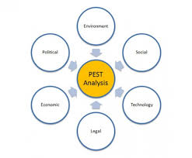
PESTAL FRAMEWORK
There are many factors in the macro-environment that will effect the decisions of the managers of any organization.
To help analyze these factors managers can categorize them using the PESTEL model.

Slide 25
Political factors
These refer to government policy such as the degree of intervention in the economy
What goods and services does a government want to provide?
To what extent does it believe in subsidizing firms?
What are its priorities in terms of business support?

Slide 26
Economic factors
These include interest rates, taxation changes, economic growth, inflation and exchange rates
higher interest rates may deter investment because it costs more to borrow
a strong currency may make exporting more difficult because it may raise the price in terms of foreign

Slide 27
Social factors
Changes in social trends can impact on the demand for a firms products and the availability and willingness of individuals to work
In the UK, for example, the population has been ageing. This has increased the costs for firms who are committed to pension payments for their employees because their staff are living longer.

Slide 28
Technological factors
New technologies create new products and new processes
MP3 players, computer games, online gambling and high definition TVs are all new markets created by technological advances
Technology can reduce costs, improve quality and lead to innovation products.

Slide 29
Environmental factors
Environmental factors include the weather and climate change
Changes in temperature can impact on many industries including farming, tourism and insurance
With major climate changes occurring due to global warming and with greater environmental awareness this external factor is becoming a significant issue for firms to consider

Slide 30
Legal factors
These are related to the legal environment in which firms operate.
Legal changes can affect a firms costs (e.g. if new systems and procedures have to be developed) and demand (e.g. if the law affects the likelihood of customers buying the good or using the service)
Interest on saving bank a/c

Slide 31

Michael Porter 5 Force Model
“An industry’s profit potential is largely determined by the intensity of competitive rivalry within that industry”
The model of the Five Competitive Forces was developed by Michael E. Porter determine the intensity of competition and hence the profitability and attractiveness of an industry

Slide 32
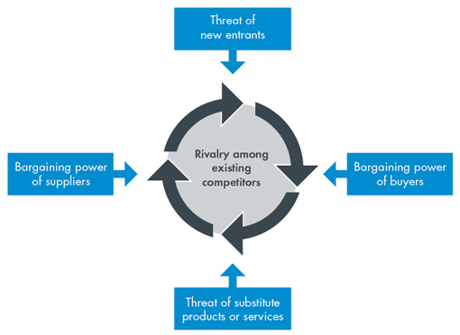

Slide 33
Bargaining Power of Suppliers
The term suppliers comprises all sources for inputs power of that are needed in order to provide goods or Supplier services Supplier bargaining power is likely to be high when:-
The market is dominated by a few large suppliers rather than a fragmented source of supply
There are no substitutes for the particular input
Employee solidarity

Slide 34
Bargaining Power of Buyers
Determines how much customers can bargaining impose pressure on margins and volumes. power of Monospony buyer’s
Customers bargaining power is likely to be high when
Buyer’s are concentrated
Buyer’s purchase significant proportion of production
The customer knows about the production costs of the product
Low when Producer supply critical of buyer’s input

Slide 35
Threat Of New Entries
The threat of new entries will depend
Threat of on the extent to which there are New Entrants barriers to entry . These are,
High initial investments and fixed costs
Brand loyalty of customers
Scarcity of important resources, e.g. qualified expert staff
Existing players have close customer relations

Slide 36
Threat From Substitutes
A threat from substitutes exists if there Threat of are alternative Substitutes products with lower prices of better performance parameters for the same purpose
The threat of substitutes is determined by following factors
Brand loyalty of customers
Close customer relationships
Current trends.

Slide 37
Intensity of Rivalry
The intensity of Rivalry competition between existing players between Existing (companies) in an industry Players Competition between existing players is likely to be high when.
There are many players of about the same size
Players have similar strategies
There is not much differentiation between players and their products.

Slide 38
Thus, Porters Model of Five Competitive Forces is a simple but powerful tool for understanding where power lies in a business situation.
It helps to understand both the strength of your current competitive position & the strength of a position you are looking to move into.

Slide 39
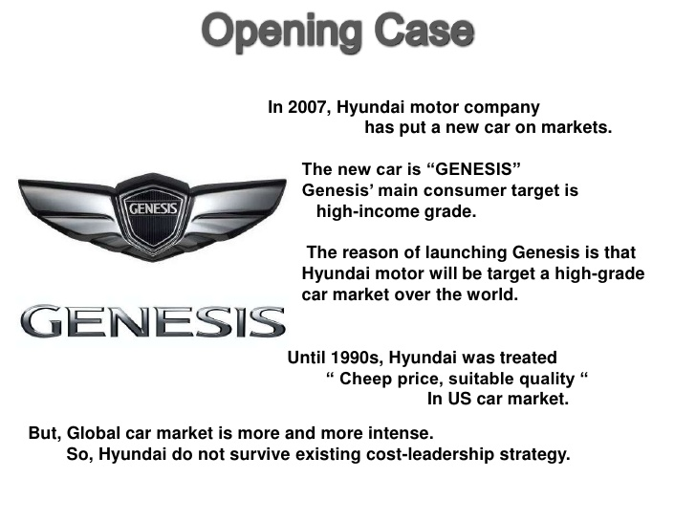

Slide 40
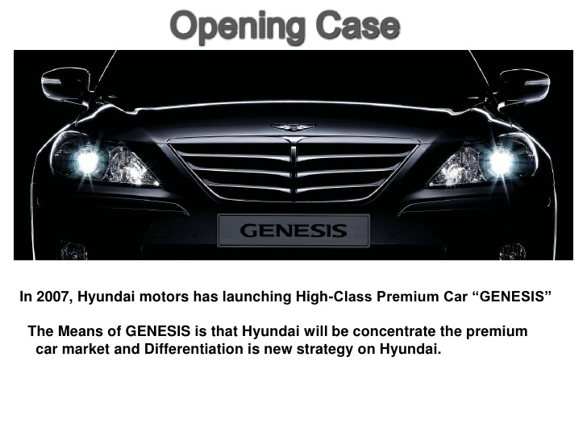

Slide 41
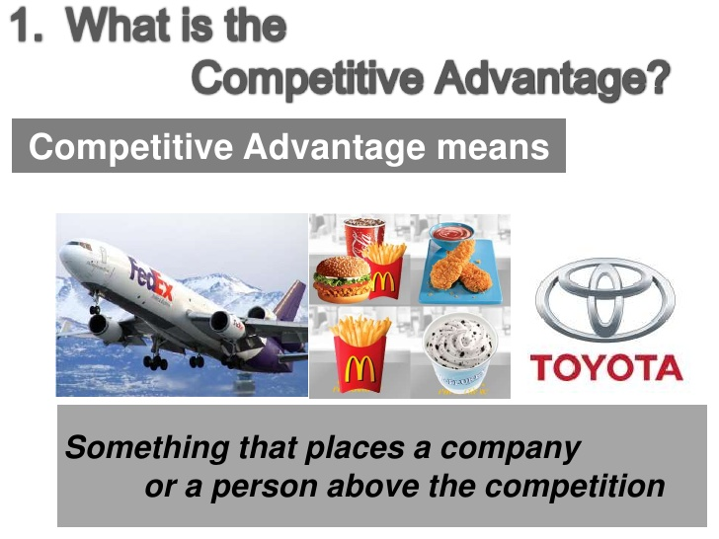

Slide 42
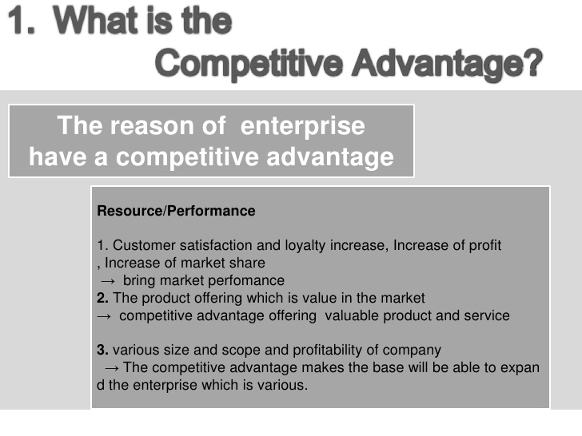

Slide 43
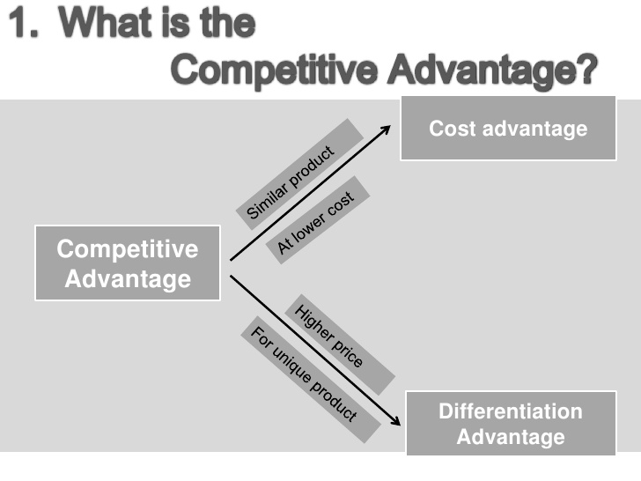

Slide 44
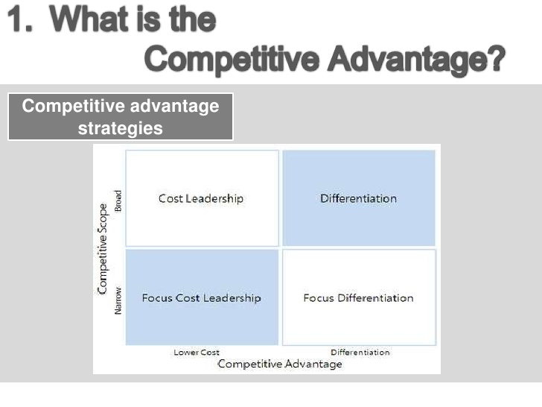

Slide 45
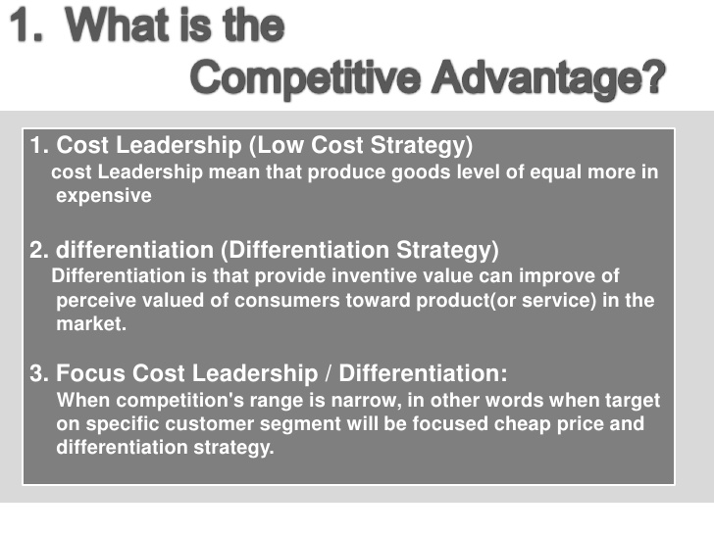

Slide 46
A focused differentiation strategy means targeting a small group of customers with differentiated products.
E.g.: The dedication of Mercedez-Benz to cutting-edge technology, styling, and safety innovations has made the firm’s vehicles prized by those who are rich enough to afford.

Slide 47
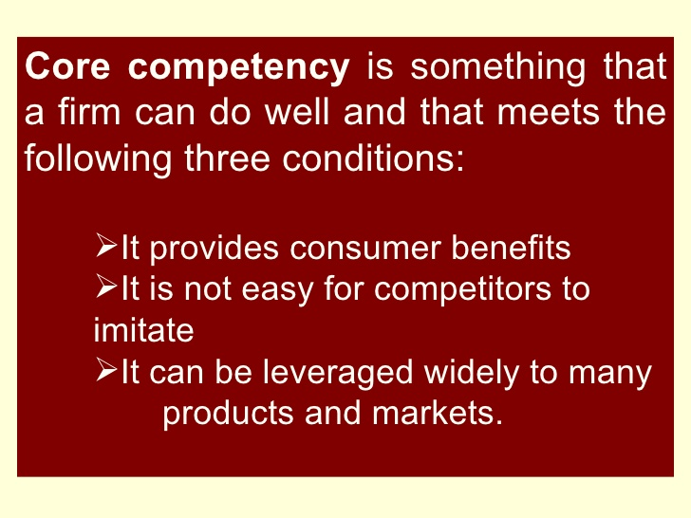
CONCEPT OF CORE COMPETENCE

Slide 48
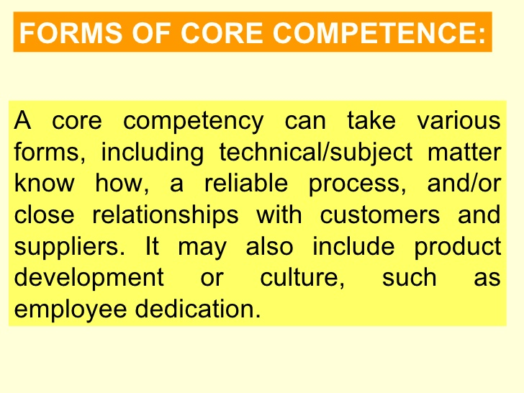
AN OVERVIEW

Slide 49
A Definition of Strategic Planning
The process by which the guiding members of an organization envision its future and develop the necessary procedures and operations to achieve that future . . . Envisioning involves a belief that aspects of the future can be influenced and changed by what one does now . . . that you can do more than plan for the future; you can help the organization create its future.” -- Pfeiffer

Slide 50
Strategic Planning: The Purposes
Strategic planning is an ongoing and dynamic process designed to:
• Ensure a consistent, clear purpose throughout the organization
• Provide a point of reference for all management decisions

Slide 51
Gain commitment from those within the organization by clearly communicating the direction and priorities of the organization’s business
Achieve understanding and support from those outside the organization who are important to its success

Slide 52
The Strategic Planning Process
The key elements include:
The articulation of the organization’s vision and mission
The identification of emerging trends
The assessment of stakeholder expectations
The selection of key results areas
The development of priority goals &
The design of implementation strategies and measures of success
The documentation of achievement, the monitoring of the plan & refining the process

Slide 53
Types of Strategies or Generic Strategy alternatives
with respect to Products/Markets/Functions
EXPANSION STRATEGY:
They are adopted in case of highly competitive and volatile industries in introduction stage of product/service life cycle.
2. STABILITY STRATEGY:
It is better choice when environment is less volatile and product reached maturity stage of PLC

Slide 54
3.RETRENCHMENT STRATEGY
When the firm is not doing well in terms of sales & revenue and finding greater returns some where, product in decline stage of PLC.
4.COMBINATION STRATEGY:
It combines other strategies ,suitable for multiple Strattegic Business Units (SBU) and changes occurs in PLC.Ex: Sub-contracting, Cross-licensing, Joint ventures.

Slide 55
Strategy Formulation and Implementation
Identification of mission and objectives
Environmental Scanning
Generic Strategy Alternatives
Strategy variations
Strategic Choice
Allocation of resources and formulation of
organizational structure
Formulation of plans, policies, programmes,
and administration
Evaluation and control

